Slide 1
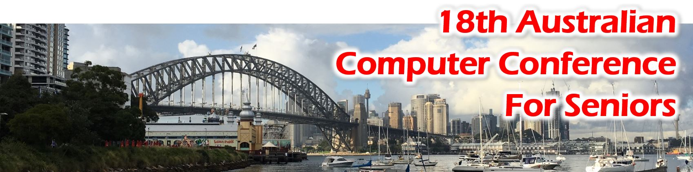
Sydney
8/9 November 2016

Slide 2

Bridging the Digital Divide
Examples from around the world
18th Australian Computer Conference for Seniors Sydney - 8/9 November 2016
Moira Allan
Co-founder and International coordinator
Notes:
Thank you – so happy to be here – wanted to come ever since school – map commonwealth – and now I am here
Humble and excited
I stand here not as an expert in the digital world but as the co-founder and international coordinator of the PASS IT ON NETWORK
As such privileged to have been exposed to example around the world

Slide 3
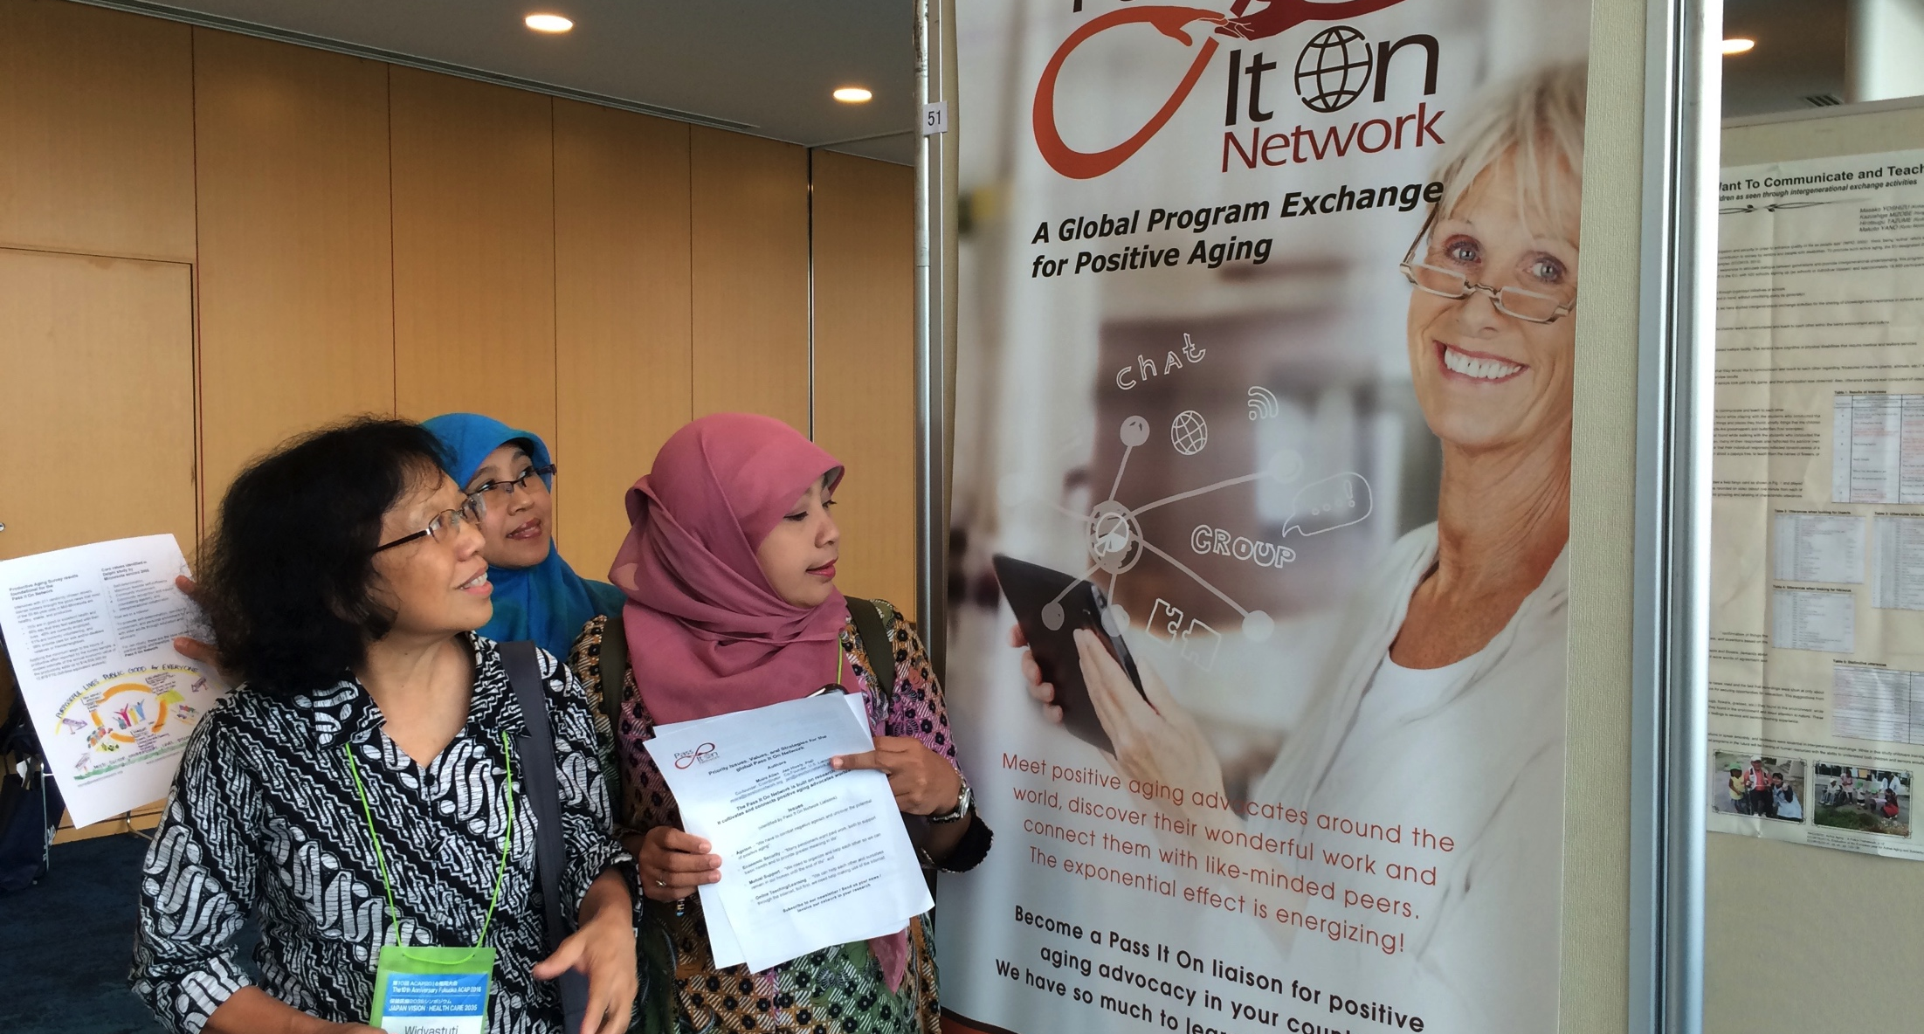
The Pass It On Network on show at the Active Aging Consortium of Asia Pacific – March 2016
Notes:
Before going into examples around the world i am going to tell you –the evolution of the Pass it On – link to Nan Bosler

Slide 4
Mission
Empower maximum self-determination and active community participation.
Promote Positive Aging through education and advocacy that directly supports individual exercise of the six (Physical, Mental, Social, Emotional, Vocational, Spiritual) Dimensions of Wellness .
Encourage people to identify and share their strengths (asset-based approach) through intergenerational and peer-to-peer networking. To help themselves, each other and their communities.
Reality
Living the
Longevity Revolution
in Real Time.
It’s up to us
Notes:
Living Longevity Revolution Real Time make it as good as we can for ourselves; our famolies an commnities
Vision
Mission

Slide 5
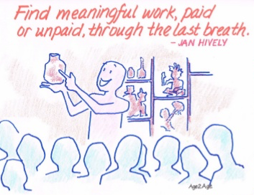

Technology made it happen
2007 – The First Aging Conference.
“2Y2R”
Notes:
This all started 10 years ago ….

Slide 6

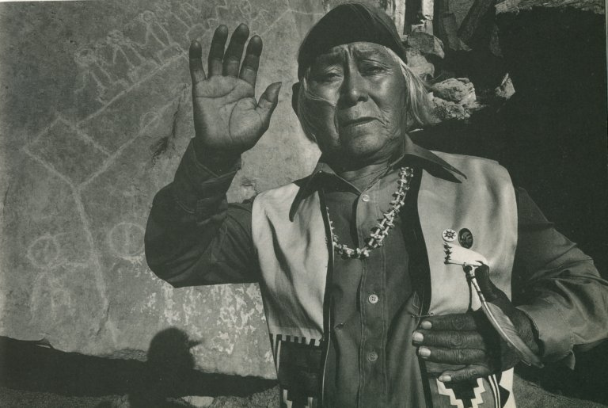
2009
“We are the ones we have been waiting for!”
  Proposal for creating a global network for positive aging.
~ Hopi Indian Leader
Notes:
Hopi Indian poem

Slide 7
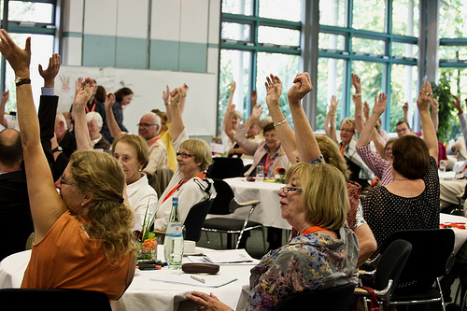
2012 – Year of active aging.
  European voices for Active Aging European Commission funding
  World Cafes – Six European countries
Notes:
European Voice for Active Aging

Slide 8
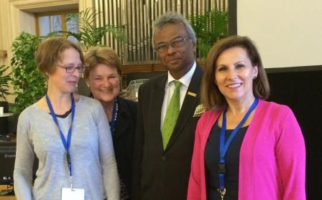
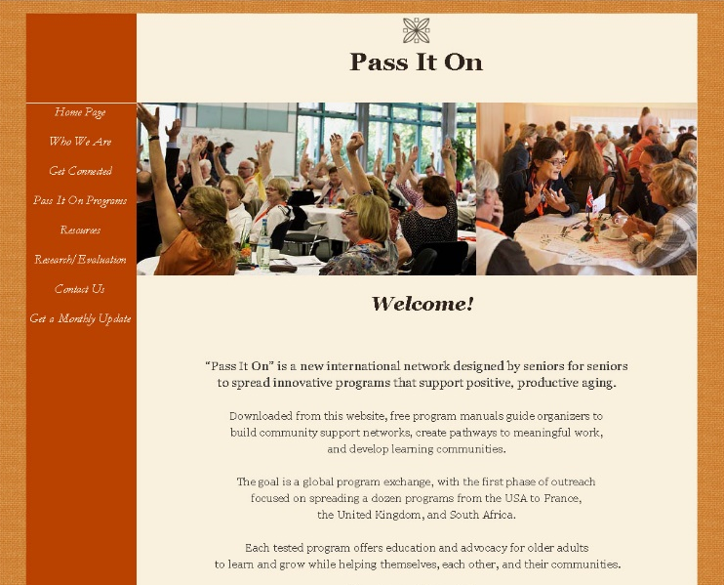
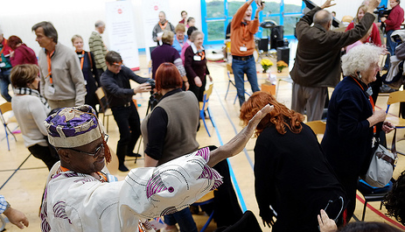
2013 - “THE BIG IDEA”
  Pass It On Network presented at the Encore Summit in San Francisco.
  Launched website in Paris November
Notes:
Grew into the äss it on Network – launched 3 year ago in Paris

Slide 9
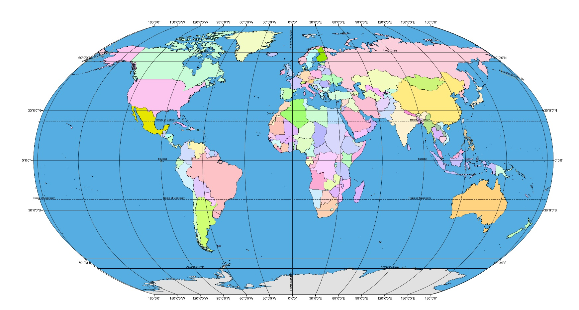
Global is fun and very do-able !!!
Notes:
Today global and growing – no one in Australia – Hope to remedy that! See me tomorrow Quarterly conferences – tried many supports now working with REDSTRING platform that provides a video conferencing facility
Now do all my network work through this

Slide 10
Infrastructure
Socio-psychological
Knowledge
Three Factors
Notes:
The digital divide is not only a divide between people who have access to ICT and people who don’t. It’s also a divide between people who have knowledge of ICT and those who don’t, between people who realize the opportunities presented by ICT and those who don’t. It consists of an infrastructure gap, a knowledge gap and a psychological gap.

Slide 11
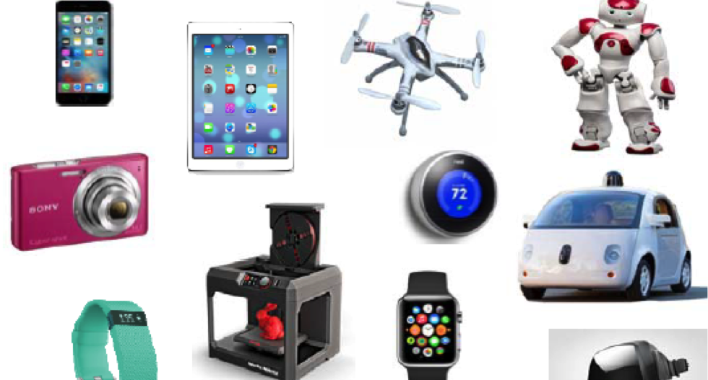
New technologies

Slide 12

International Telecommunications Union

Slide 13
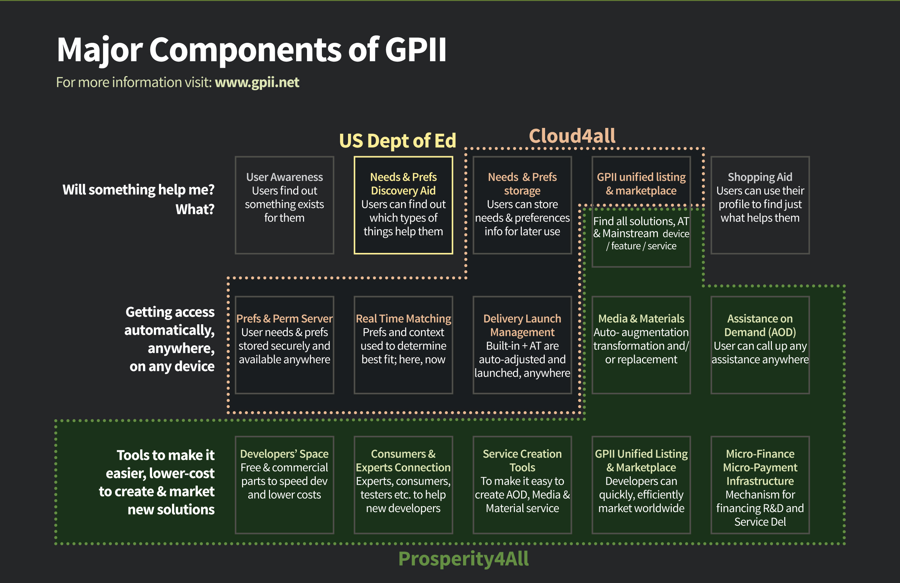
Global Public Inclusive Infrastructure
Notes:
At the same time its good to know that you have the University of South Australia working with the World Wide Web Consortium 3, the European Commission and a wide variety of businesses and academic institutions on “Raising the floor” to ensure that existing and future technologies are accessible to everyone with disability, literacy, and aging-related barriers, regardless of their economic status. They are all building a Global Public Inclusive Infrastructure (GPII) to make it easier and less expensive to create an inclusive (digital) society drawing on, for example, research projects such as the Cloud4All and Prosperity4All
Origin of the Global Public Inclusive Infrastructure (GPII)

Slide 14
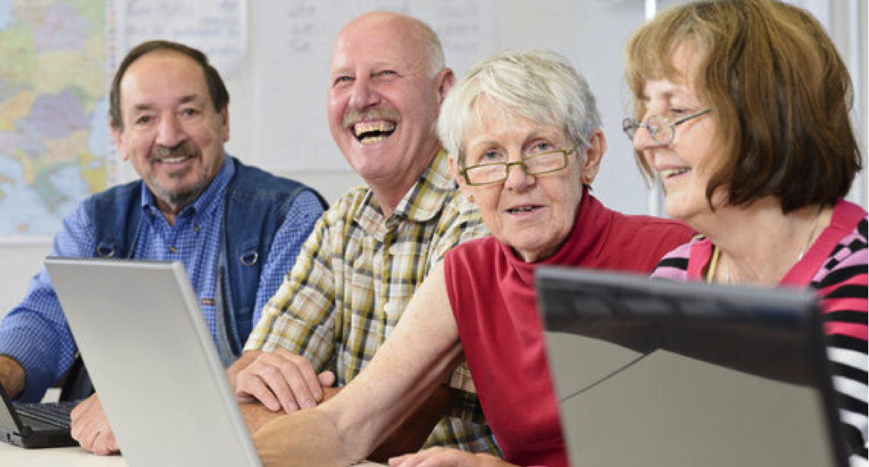
USA – Delighted OATS learners (Older Adult Technology Services)
Notes:
OATS – Older Adults Technology Services
executive director, Tom Kamber, noting that federal stimulus funds had helped build 3,000 computer labs around the country. “We’re right on the cusp of creating a powerful national program that will reach hundreds of thousands of seniors a year.” And quotes Muriel Beach, an 85-year-old OATS alumna who says “These classes provide a doorway for seniors to the wider world,”

Slide 15
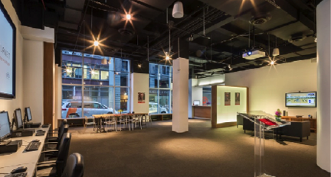
USA – Senior Planet’s exploration centre in Manhattan
Notes:
In Manhattan, OATS just opened a snazzy 2,700-foot Senior Planet Exploration Center in Chelsea, the country’s first tech center specifically for those over 60.

Slide 16
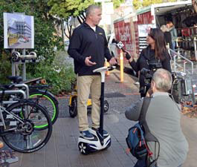

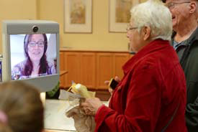
The new GenLab in California
Notes:
Richard Adler – research associate at the Institute for The future and one of our advisors -

Slide 17
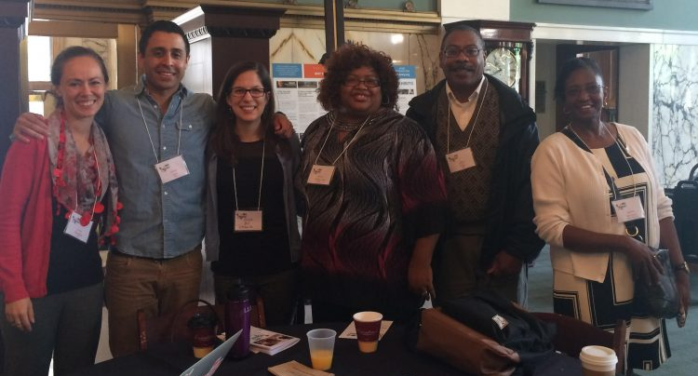
USA –Digital Inclusion Fellows
Google Fibre & Nonprofit Technology Network
Notes:
Google Fiber and the Nonprofit Technology Network (NTEN) launched Digital Inclusion Fellows this year. Training advocates to create and lead digital literacy efforts in different metro areas within USA. Role promote adult digital literacy and help young job-seekers learn ICT skills for entering the labor market.
Digital Inclusion Toolkit
Digital Inclusion Fellowship City Hosts
http://www.nten.org/article/digital-inclusion-fellowship-a-year-of-learning/
Impacts : six months - 16 Fellows - 1,000,000 people with awareness campaigns Trained 82 staff and volunteers monthly and trained 550 participants on a monthly basis on digital literacy skills. City Hosts made their computers labs available for over 1,000 hours per month.

Slide 18
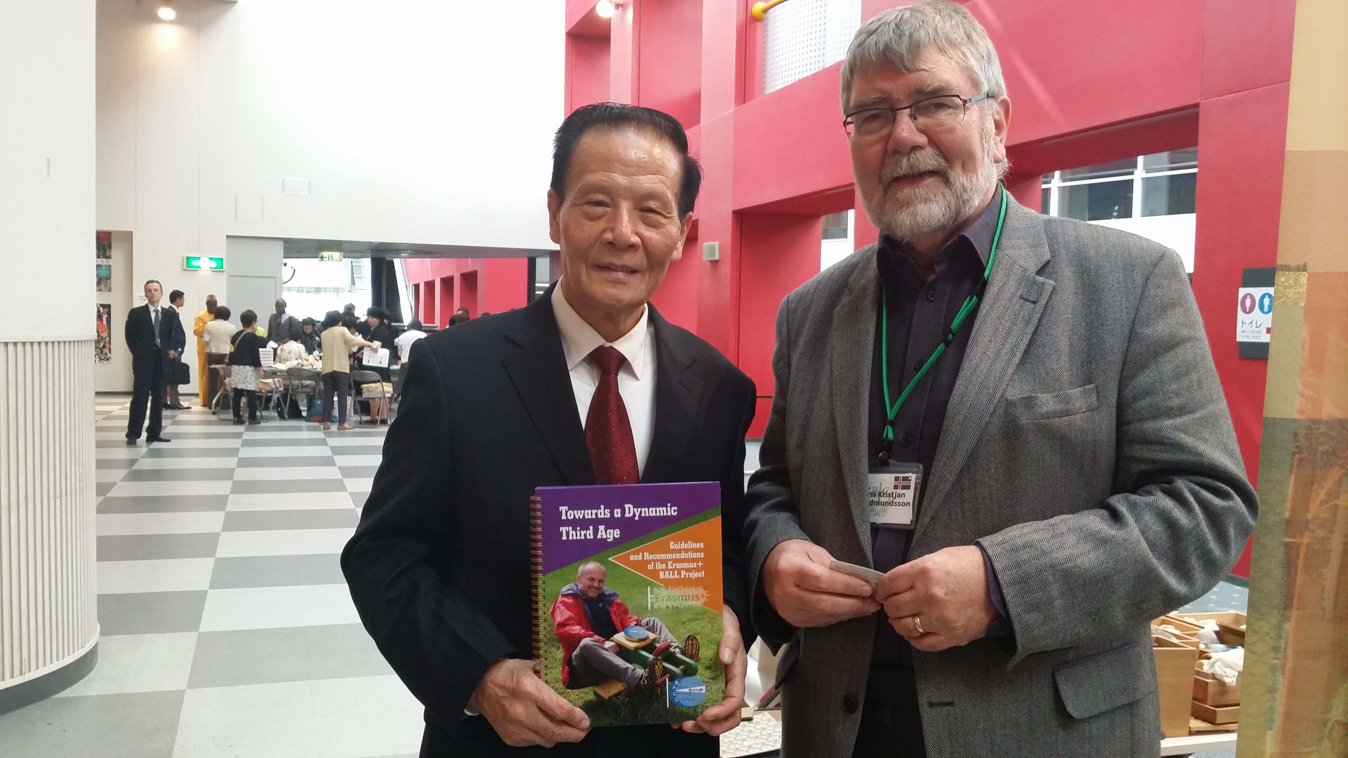
China & Iceland meet at the U3A International conference in Osaka
Notes:
Prof Yang – President of the Jingdezhen University – One of 60 000 Senior Universities in China!

Slide 19

France – digital training programs

Slide 20
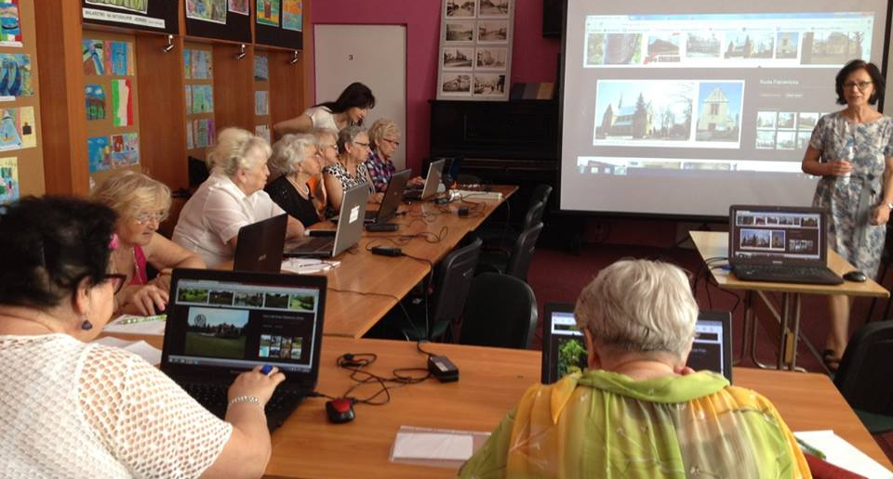
Poland – 2 600 « Lighthouse keepers » work in their local communities teaching digital skills
Notes:
Country wired, but reluctance to use if – of a population of 38 million - 10 million people never been on the Internet. Primary problem – mental barriers:
Lack of motiovation, fear, lack of undertnding of the benefits to be gained, lack of skills. : „Digital Poland of Equal Opportunities”
Ministry of Administration and Digitization and the “Cities on Internet” Association 50 + generation first step into the digital world.
The novel approach rests on locality, as adults are willing to participate in events in familiar surroundings: community centers, local fire station social spaces and even private homes. For that reason, PCRS requires involvement of local digital champions - trusted by the community, creative, skilled in mobilizing support for local actions.First phase 2600 Lighouse Keepers

Slide 21
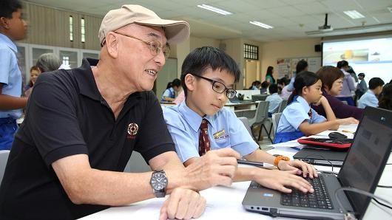
Singapore – intergenerational IT bootcamps work wonders
Notes:
The Infocomm Development Authority of Singapore (IDA) Silver Infocomm Initiative is a program designed to enhance the digital skills of seniors and provide them with available equipment for access to the web. The benefits offered by the organization consist in the establishment of free hotspots in community centers where different training alternatives are offered, including both cheap courses and support from “cyber guides” that share their knowledge with their peers.
However, in order to address the exclusion of the elderly in the digital age and increase IT awareness among the community, IDA has adopted a new approach that consists in the elaboration of Intergenerational IT bootcamps. Around 145 of these workshops have so far supported over 3,000 senior participants in the island with the collaboration of diverse civil organizations and schools.

Slide 22

Japan – ITC – the driving force to transform and develop society
Notes:
Innovative applications and strategy For the Empowerment of People with ICTs Dr. Toshio Obi Professor, Waseda University Japan
The search for appropriate measurement to exploit ICTs to benefit people is increasingly being discussed in relation to Information society paradigm, according to
which the creation, distribution, diffusion, use, integration and manipulation of information by the means of ICTs is the driving force behind transformation and
development of a society. In information society ICT infuse every aspect of life from business to government providing new and powerful tools, which enable more (1)
Convenient, (2) friendly, (3) transparent,(4) inexpensive, and (5) faster communication and transactions between the parties.

Slide 23
e-Government
Healthcare
New traffic systems
Disaster prevention
Housing – smart homes
Lifelong education
Social participation
Pro-elderly employment
Nursing care
Safe and secure systems
ICT for an aging society
Japan’s Major areas
Notes:
the government of Japan established a taskforce on ICT applications for Ageing Society under both Japanese Ministry of Internal Affairs and
Communication and Local Authorities Systems Development Center (LASDEC) in 2010.

Slide 24
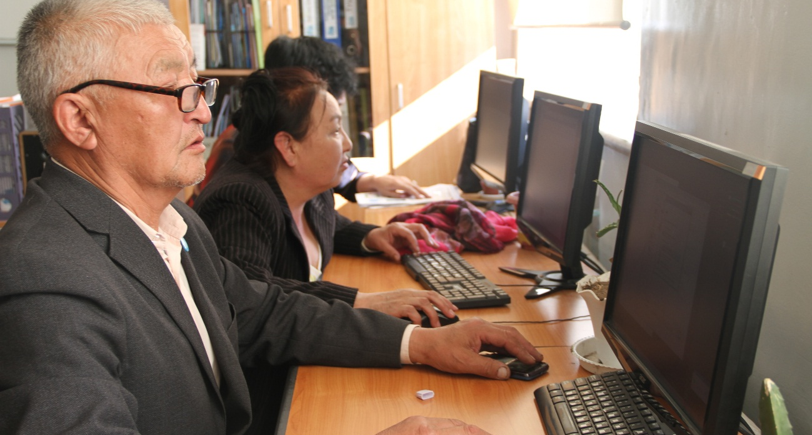
Mongolia’s Liberal Federation of Senior Citizens leading digital training
Notes:
Liberal Federation of Senior Citizens of Mongolia,

Slide 25
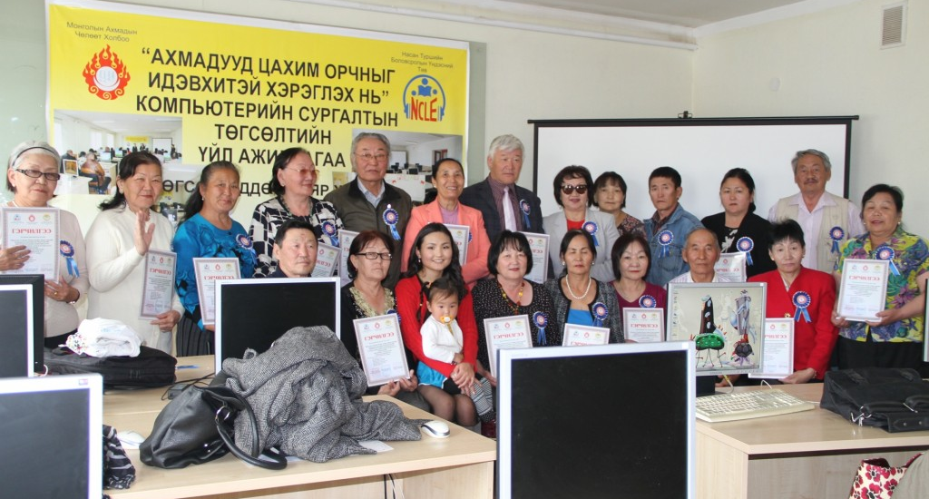
Mongolia – graduation time

Slide 26
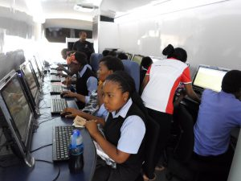
South Africa – priority to young people

Slide 27
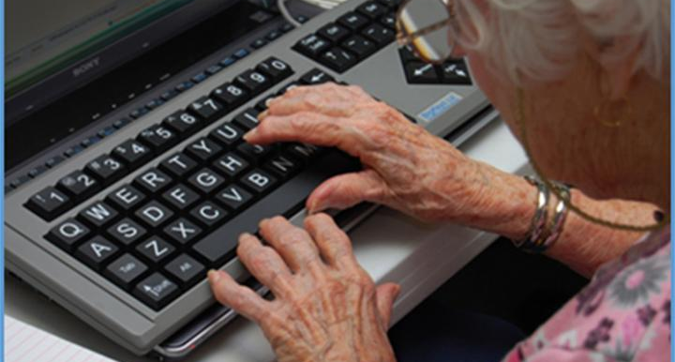
Scientifically proved – We love it!

Slide 28
Slovenia

Slide 29
Slovenia – Everyone teach one

Slide 30
Moira Allan moira@passitonnetwork.org
Jan Hively
(Janet M Hively, PhD)
HIVEL001@umn.edu
Co-Founder and U.S. Liaison, Pass It On Network

Slide 31
